Slide 1
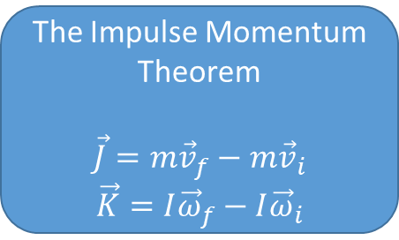
Rigid Body Kinematics
Rigid Body Impulse Momentum
Impulse
Translational
Rotational
Momentum
Translational
Angular
The Impulse Momentum Theorem
$$\vec{J}=m{\vec{v}}_{f}−m{\vec{v}}_{i}$$
$$\vec{K}=I{\vec{ω}}_{f}−I{\vec{ω}}_{i}$$
Coefficient of Restitution
Rigid Body Surface Collisions
Rigid Body Free Collisions

